Slide 1
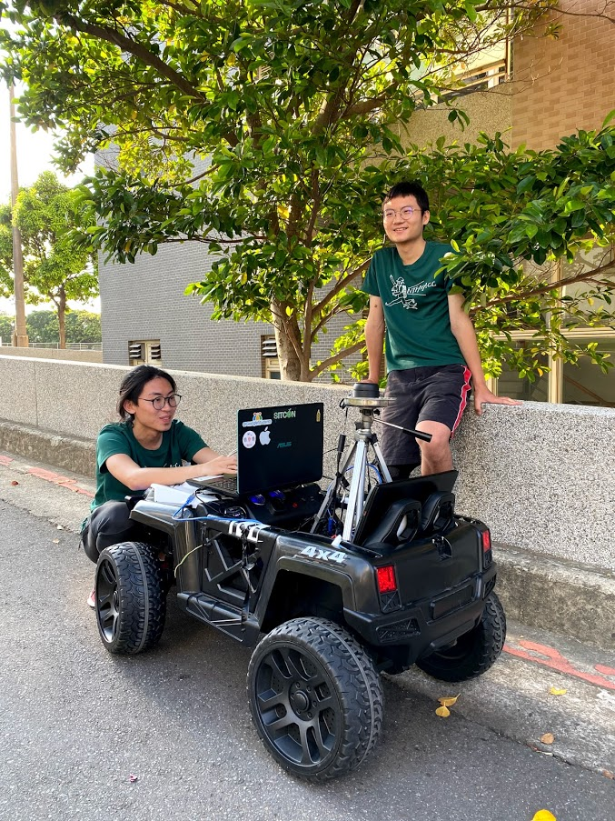
基於RTAB-MAP的
室外自動導航系統的實現
組別：A90
組員名單：許晏誠、何立平、張瀚
指導教授：邱偉育 prof.

Slide 2
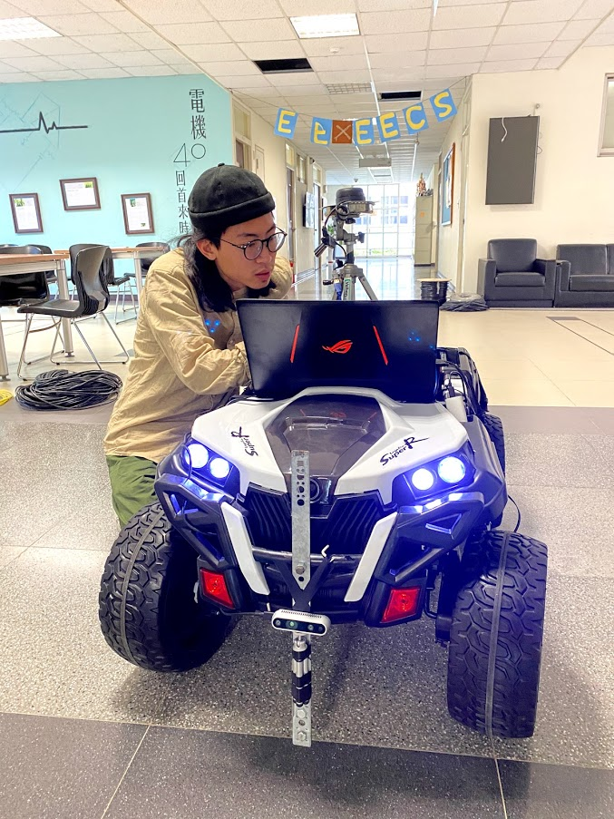
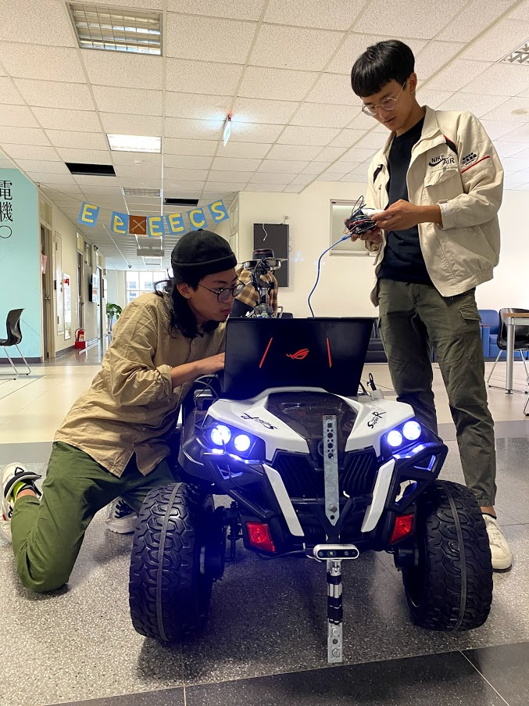
許晏誠
107061126
電機系
張瀚
107061130
電機系
何立平
107000206
電資班

Slide 3
How Autonomous Navigation works?
Motion Planning & Control
Local Planner
& Hardware controller
Local Planner
(Costmap)
Obstacle avoidance
Global Planner
(Costmap)
Path planning
Cognition of the Environment
SLAM

Slide 4
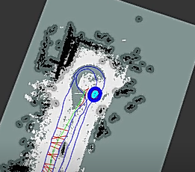
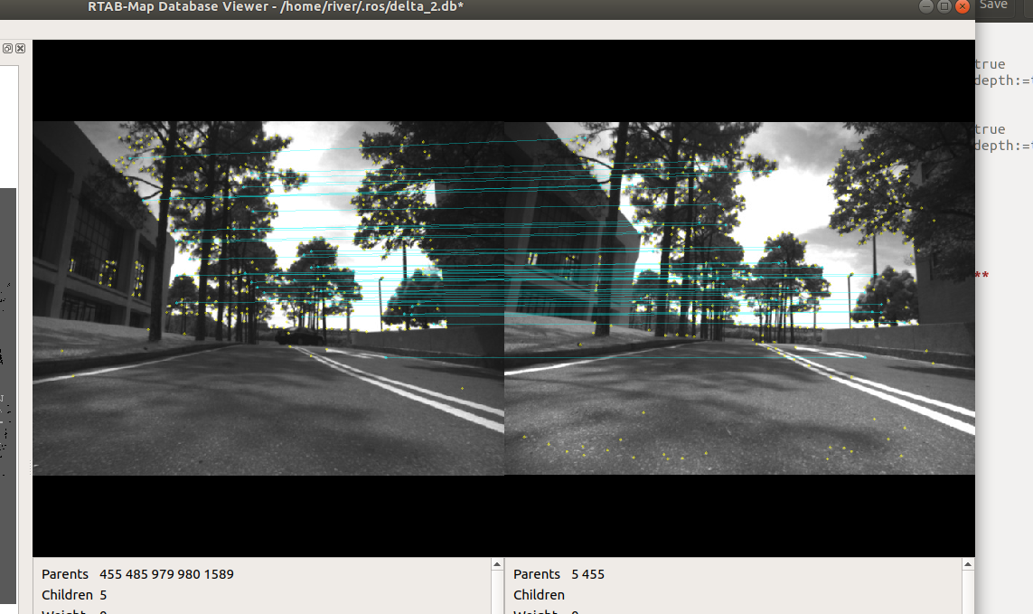
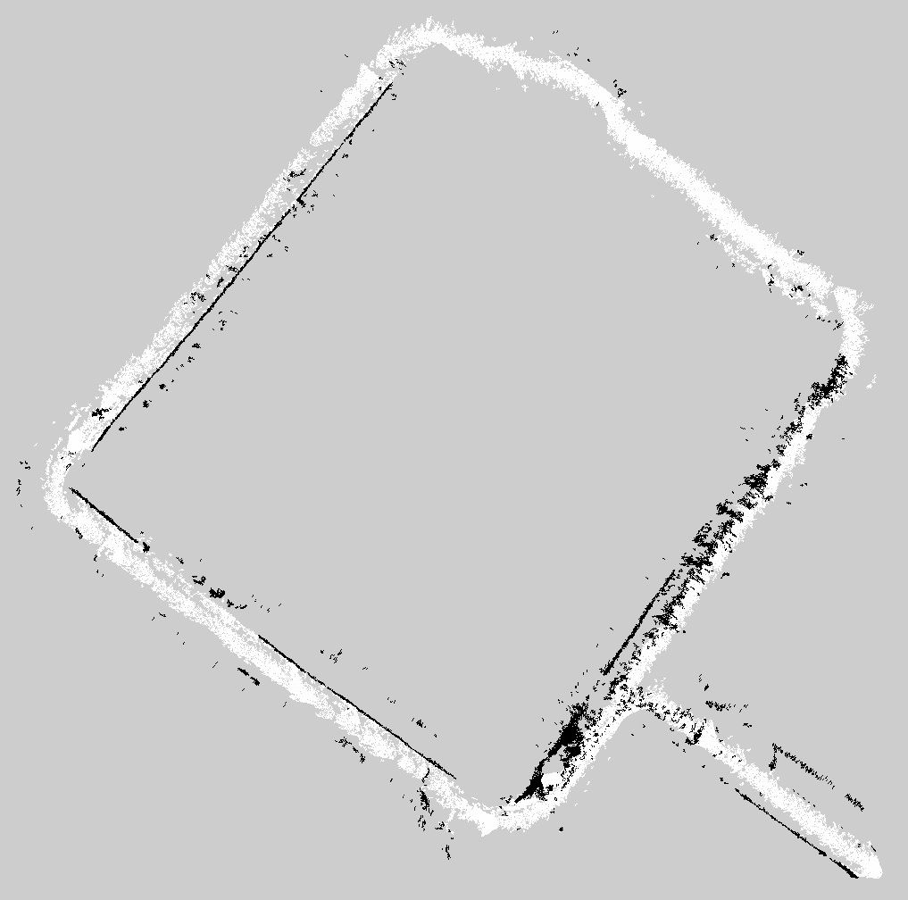
Autonomous System Flow (Exploration & Pre-Built Mode)
SLAM
Navigation
Local
costmap
Local
planner
Arduino
(Hardware)
Sensor
Pointcloud & Laser Scan
Obstacle location
Input Image
trajectory
(movement instruction)
Feature Extraction
Feature point
(Pointcloud)
Global
path
Loop Closure Detection
Odometry
Location & Poses
Global
costmap
Global
planner
Mapping
Static map
Static map

Slide 5
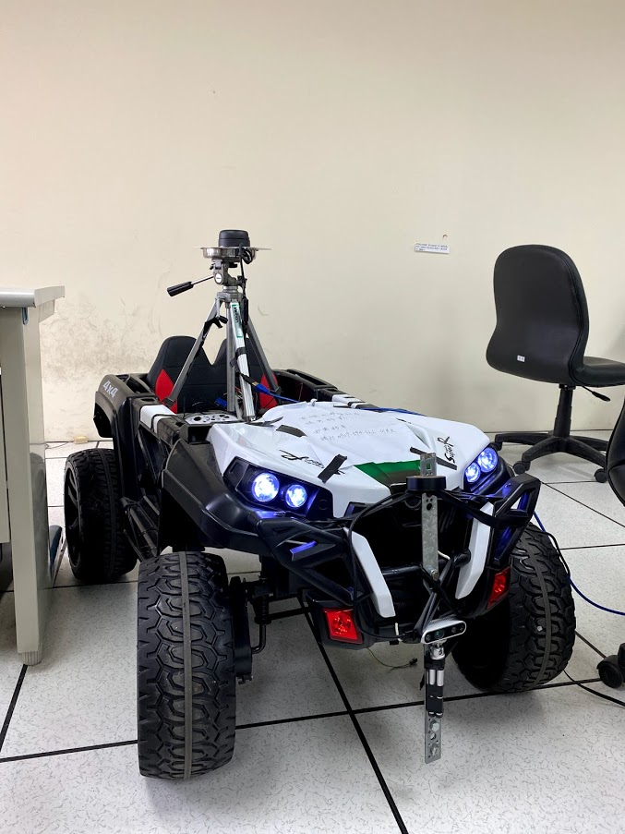
硬體架構
光達
車體：阿克曼轉向架構
深度攝影機
相機
光達
阿卡漫架構
The model of our hardware system is based on a four-wheel drive RC remote car.
Four-wheel driving and a large storage area enabled us to lay our laptop which works
as the computing core, on the car. Sensors are set up according to the tf including a
RGB-D camera which can also perform as a stereo camera and a 2D lidar which allows
the robot to detect the obstacle 360. Fig. 10 shows our robot model containing a Lidar
on top and stereo camera at the front.

Slide 6

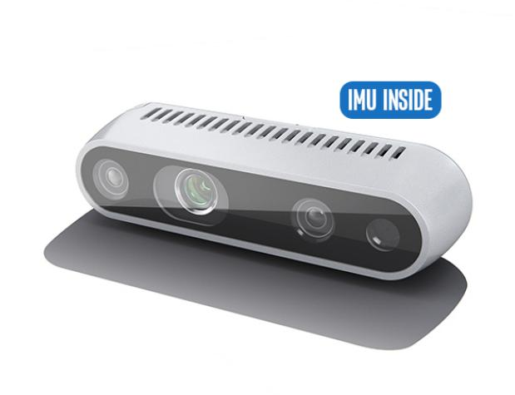
位置
深度攝影機
功能
避開前方的障礙物
環境3D地圖的建立
車體座標的定位
相機
The D435i works as the “eye” of the
robot which enables it to see the obstacle at front and
provide the image data for RTAB-MAP to build the
map and compute the odometry

Slide 7
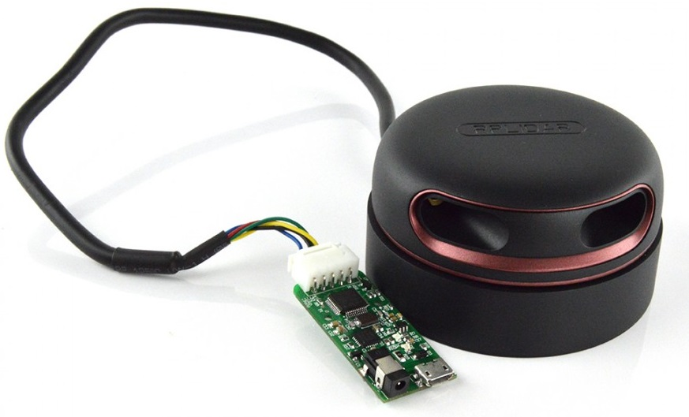
位置
光達
(lidar)
功能
可以避開360°的障礙物
優化「即時定位、地圖構建」的效果

Slide 8
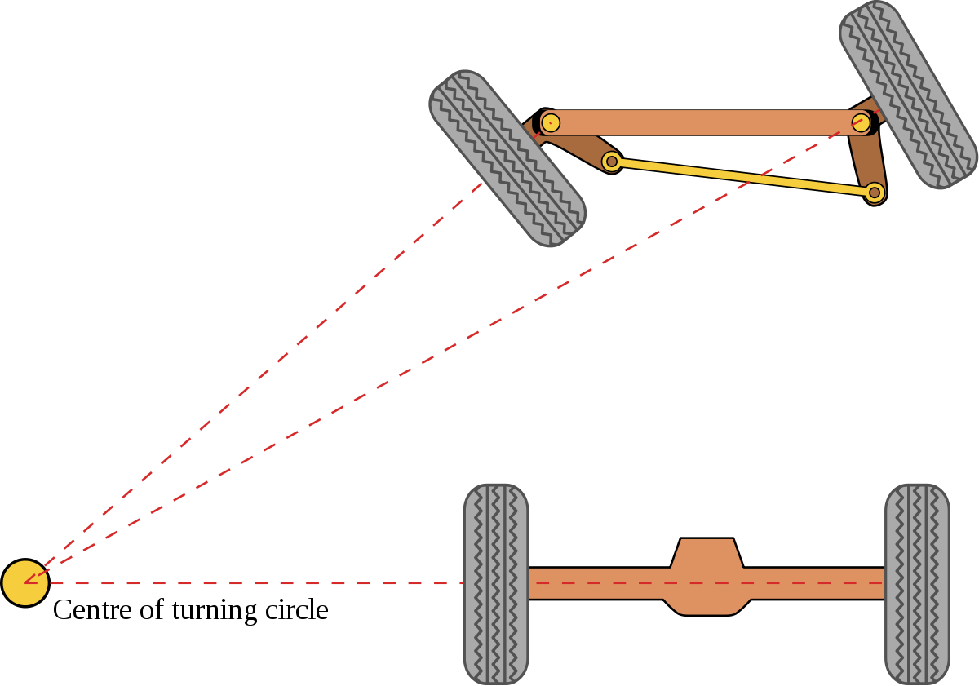
介紹
透過前輪的轉向來轉彎
用於一般轎車
阿克曼轉向架構
(ackermann steering geometry)
前輪
選用此架構的原因
車體較大、車體穩定
較符合實際自駕車的架構
後輪
This model is commonly used in ordinary cars, so it’s also called a car-like model. We
chose this steering system because car-like models are the most common one on the
road. Once the system for ackerman is integrated, there’d be no need to put extra effort
on developing differential models. Second, a stable but large enough model to meet our
purpose is hard to find, so we’d prefer the Ackerman model as our choice. The
following Fig. 9 shows how Ackerman steering geometry works.

Slide 9
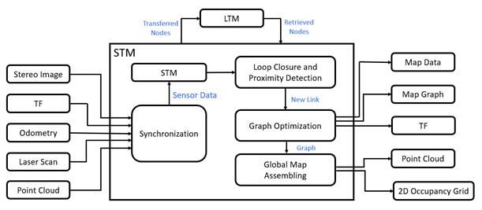
SLAM (Real-Time Appearance-Based Mapping - RTABMAP)
Sensor
Input Image
Feature Extraction
Feature point
(Pointcloud)
Loop Closure Detection
Odometry
Ref Labbé, Mathieu, and François Michaud. "RTAB‐Map as an open‐source lidar and visual simultaneous localization and mapping library for large‐scale and long‐term online operation." Journal of Field Robotics 36.2 (2019): 416-446.
Location & Poses
Mapping

Slide 10
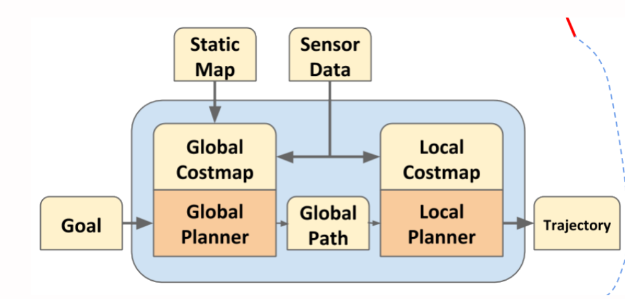
Navigation (TEB_LOCAL_PLANNER)
Teb Local Planner
Recovery Behavior
Ref: https://pojenlai.wordpress.com/2015/07/16/ros-navigation-stack-%E7%B0%A1%E4%BB%8B/

Slide 11
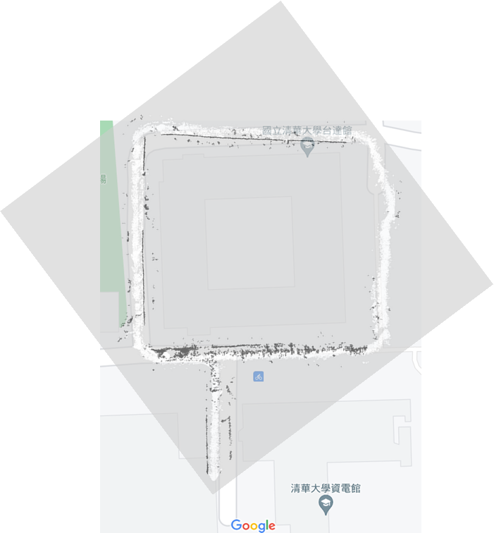
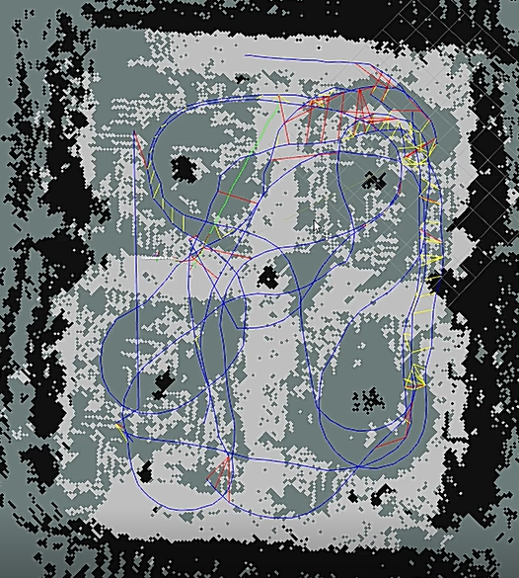
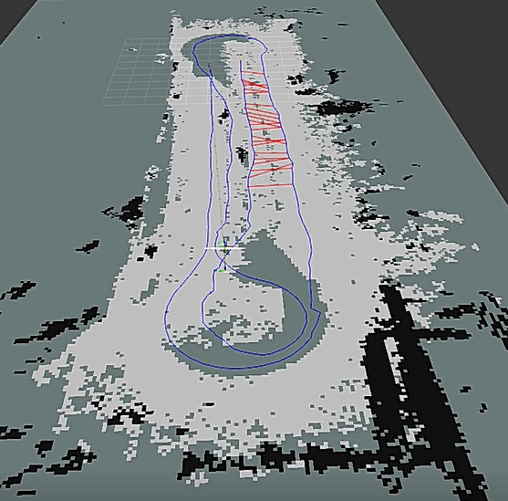
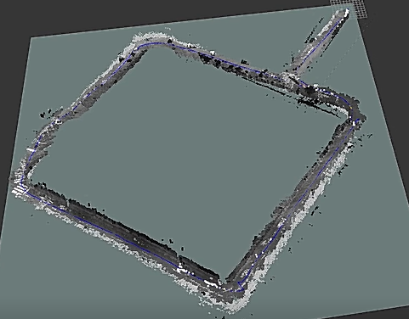
Result & Analysis (Mapping)
Precise Mapping with following concern:
Auto-Exposure ROI, Sensor position adjustment
Odometry drift or False obstacle -> Remapping
Mapping speed cannot be too fast -> Time Consuming

Slide 12
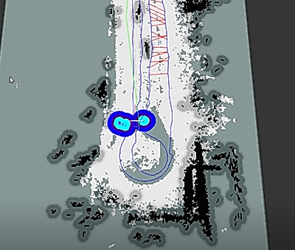
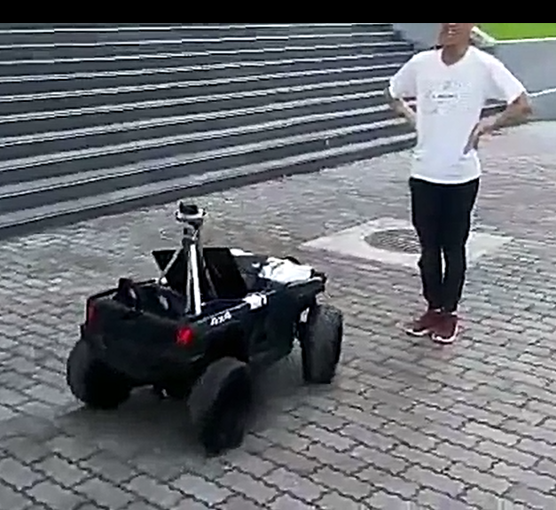
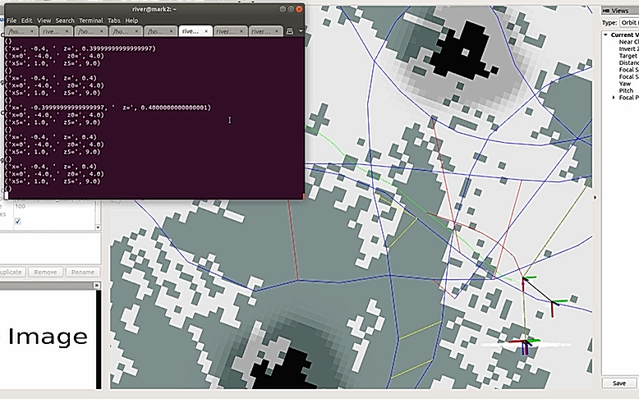
Result & Analysis (Navigation & Obstacle avoidance)
Point to Point Navigation -> Suffer from odometry drifting
Obstacle Avoidance -> Fast objects are unavoidable
Detection of in-sight object -> Restricted range of detection

